Slide 1

Sign Language Recognition System with Machine Learning
DEPERTMENT OF COMPUTER SCIENCE & ENGINEERING
BIRBHUM INSTITUTE OF ENGINEERING & TECHNOLOY, SURI, BIRBHUM
Presented by
Under Guidance of
Akash Murmu (11800119010)
Samrat Biswas (11800119005)
Prof. (Dr.) Debasri Chakraborty
Prof. Nilim Sarkar

Slide 2
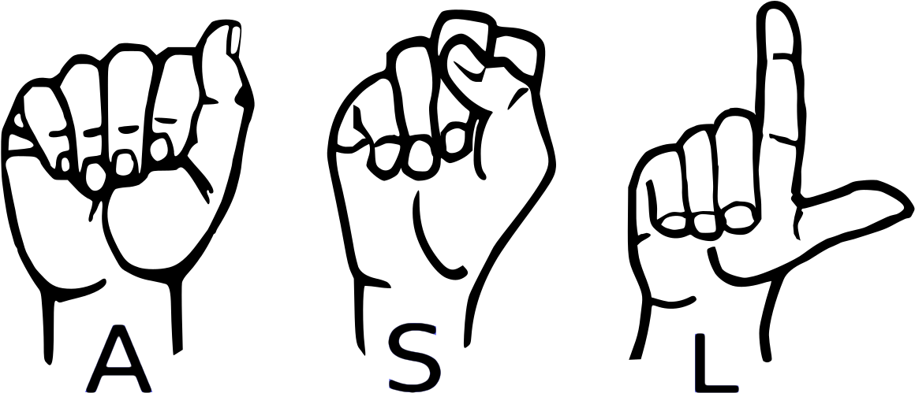
Topic to be Covered
What is Sign Language & Why It’s Important?
Motivation;
Problem Statements;
System Requirements;
System Implementation;
Result & ..;
What Next?
Conclusion.

Slide 3
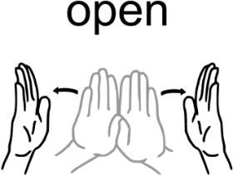
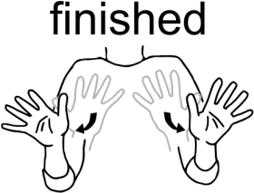
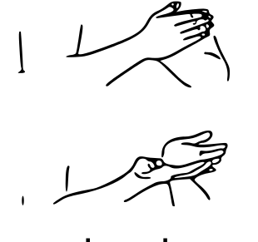
What is Sign Language?
01
Sign language is a way of communication using hand gestures and movements, body language and facial expressions, instead of spoken words.
Open
Finished
Book

Slide 4
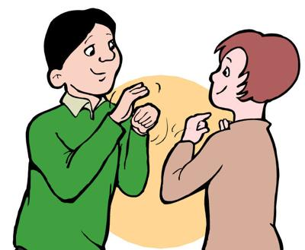
Importance Sign Language?
02
Sign Language is the only way to communicate with Deaf & Dumb people.
It gives deaf children the opportunity to educate themselves.
It also makes deaf people’s lives easier.

Slide 5
Motivation
03
Usually, Sign Language is learned by deaf & dumb people, it is not known to normal people.
It‘s a challenge to communicate with deaf & dumb people for normal people.
Our project aim is to take the basic step in bridging the communication gap between normal people and deaf and dumb people using American sign language.

Slide 6
Problem Statements
04
Realtime Hand detection;
Understanding the exact context of symbolic expression;
Recognize the hand sign and tracking the accuracy of hand gesture;
In addition, there are also sum problems like, background noise of image, high computation cost, large-scale of data.

Slide 7
System Requirements
05
Hardware Requirements (min):
Processor: Intel core i5 / AMD Ryzen 5
RAM: 8GB
Storage: 2.5GB
Graphic Card: Integrated graphics
Capture Device: External Webcam (if don’t have in-built camera)

Slide 8
System Requirements
06
Software Requirements (min):
Python 3.10
Operating System: Windows 7 or higher/ Linux / MAC OS
IDE: VSCode / PyCharm / any other IDE

Slide 9
System Requirements
07
Other Requirements:
Python Modules
TensorFlow (2.11.0)
Keras (2.11.0)
MediaPipe (0.9.0)
Scikit-learn (1.1.3)
OpenCV(4.6.0.66)
Pandas (1.5.1)
NumPy (1.23.1)
Matplotlib(3.7.1)

Slide 10
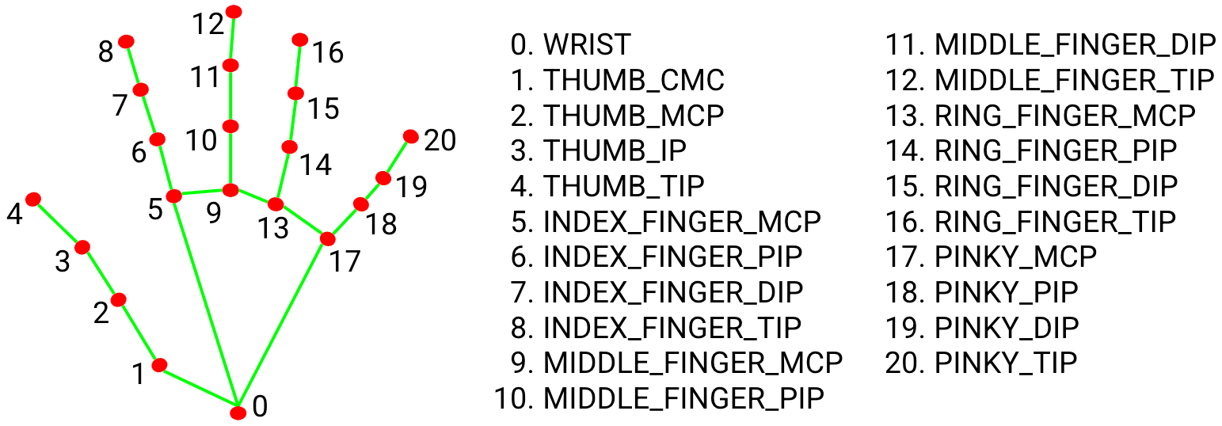
System Implementation
08
Data Collection: As it is a Computer Vision based approach our data is 2D Key-points of hand.

Slide 11
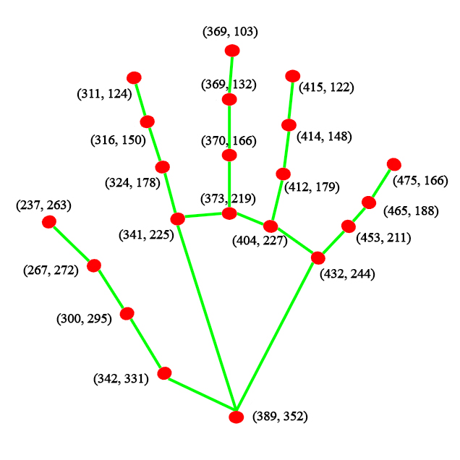
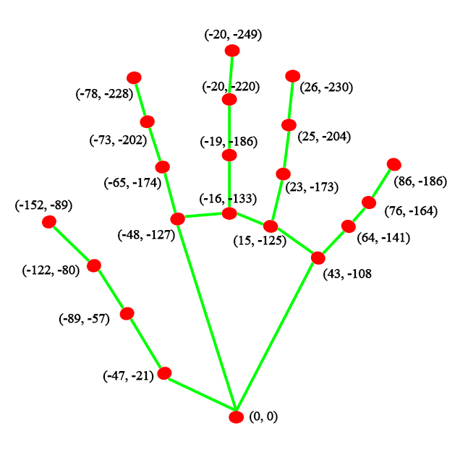
System Implementation
09
Processing Landmarks:
a
b

Slide 12
System Implementation
09
Processing Landmarks:
[[389, 352],
[342, 331],
[300, 295],
[267, 272],
[237, 263],
[341, 225],
[324, 178],
. . .
. . .
[432, 244],
[453, 211],
[465, 188],
[475, 166]]
[[0, 0],
[-47, -21],
[-89, -57],
[-122, -80],
[-152, -89],
[-48, -127],
[-65, -174],
. . .
. . .
[43, -108],
[64, -141],
[76, -164],
[86, -186]]
[[0, 0],
[-0.25, -0.137755102],
[-0.43877551, -0.382653061],
[-0.5, -0.62244898],
[-0.397959184, -0.806122449],
[-0.275510204, -0.709183673],
[-0.275510204, -0.964285714]
. . .
. . .
[0.209183673, -0.647959184],
[0.219387755, -0.852040816],
[0.163265306, -0.683673469],
[0.137755102, -0.56122449]]
Original
Landmarks
Relative
Landmarks
Normalized
Landmarks

Slide 13
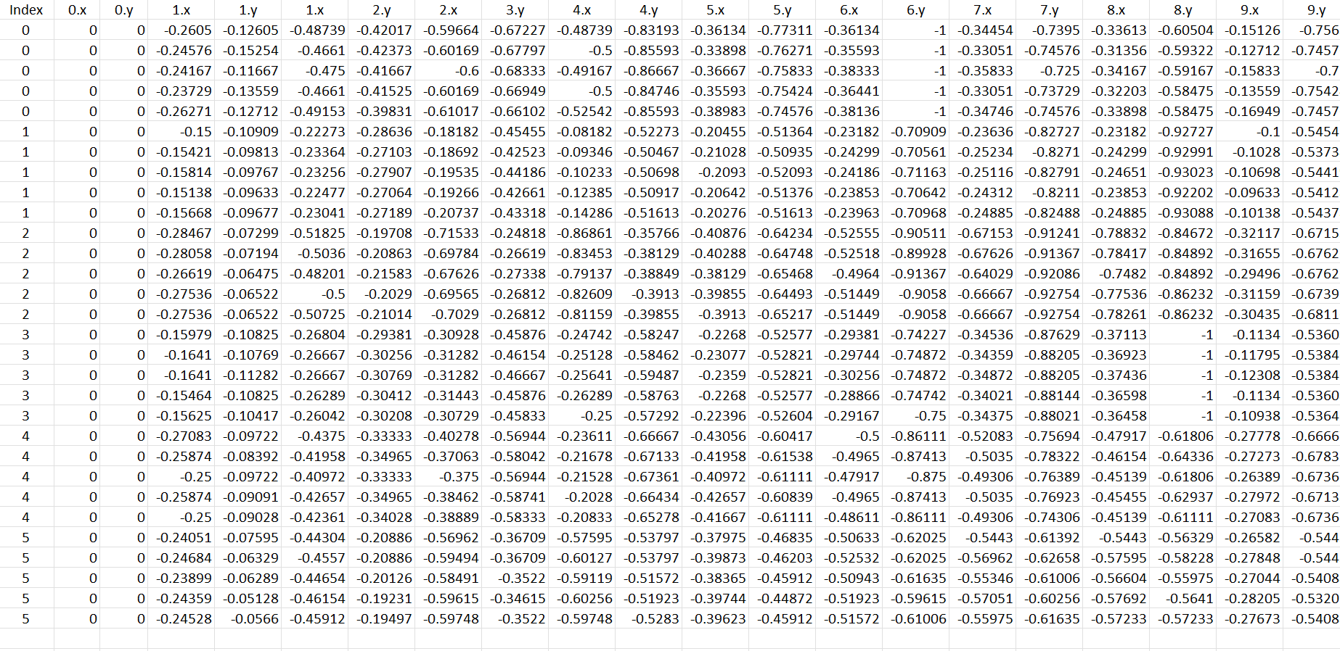
Sample Dataset
10

Slide 14
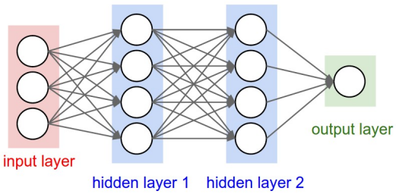
System Implementation
10
Training Model:
Load and separate train-test data.
In order to train the model, we used 24000 sample data. Every sample data has 42 attributes (2D Coordinates).
3 Dense Layer and 2 Dropout Layer are used to train the Feedforward model.
Activation Function: ReLU & Softmax.
Loss Function: Sparse Categorical Crossentropy

Slide 15
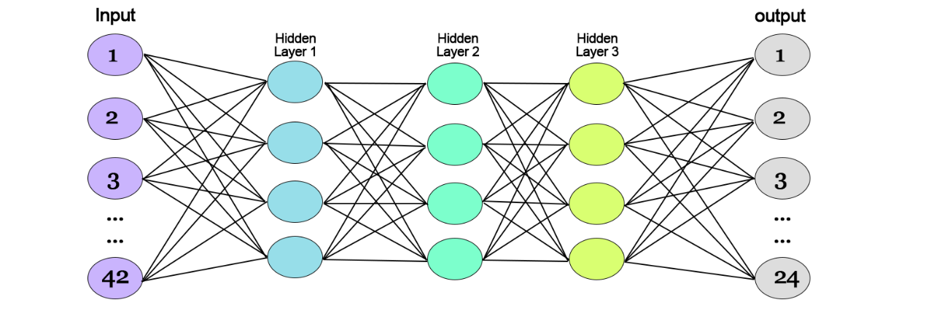
System Implementation
11
Convolutional Neural Networks:
Dense-1
Dense-2
Dense-3

Slide 16
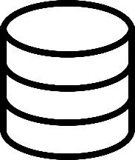
System Implementation
11
Testing Model:
Getting Test Dataset
Dataset
Train Machine Learning Model
Test Data
Fine-tune the Architecture & Hyper Parameters of Model
Get Desired Accuracy?
Classification Using Machine Learning Model
False
True
Output

Slide 17

System Implementation
12
Real-time Testing:
Capturing image from camera feed.
Process image same as done during training model.
Feed image array to the trained model.
Getting output.
Capture Image
Process Image
Feeding to the Trained Model
Predicting Class
Output

Slide 19
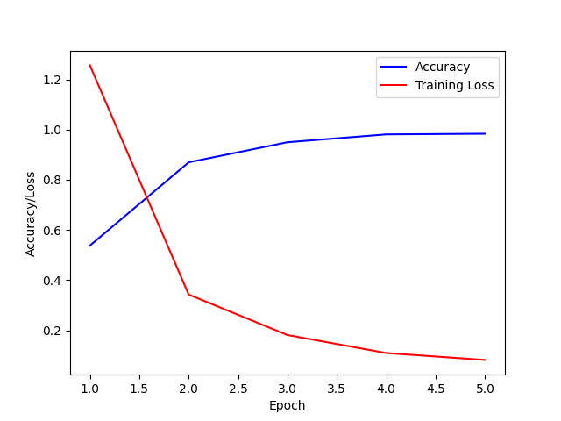
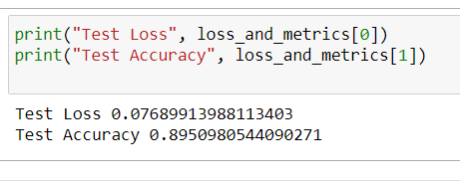
Result
13
Train Result
Accuracy:
Training Accuracy: 96.3%
Test Accuracy: 89.5%
Loss:
Training Loss: .0644%
Test Loss: .0768%
Train Result

Slide 20
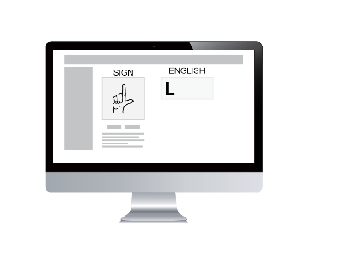
What Next?
14
Recognize other gestures like- Number, Words, Instructions etc.
Also recognize dynamic signs.
Implement speak functionality.
Finally implement a beautiful User Interface.

Slide 21
Conclusion
15
In this project we proposed an idea for feasible communication between deaf & dumb and normal people by using Machine Learning & Image Processing.
Our proposed project ensure accuracy of 96.3%.
But there is some problem with real time testing.

Slide 22
Thank You !
Any Question?
Notes:
© Samrat Biswas

